Slide 1

HR ANALYSIS DASHBOARD PROJECT

Slide 2
Team Members
01
04
Omar Eissa Ibrahim
Rawda Raafat Ramadan
02
05
Omar Mahmoud Kamel
Maryam Ahmed Salah El-Din
03
06
Diana Adel
Habiba Ragab Mohamed

Slide 3
PROJECT OVERVIEW
This project analyzes Human Resources Data to Uncover workforce patterns and generate meaningful insights. It focuses on key areas such as Employee Demographics, hiring trends, department distribution, and attrition rates to better understand organizational dynamics.
The analysis Helps Identify Factors that impact employee retention and workforce Planning. The Final Outcome Is an Interactive Dashboard That Presents These Insights in a clear and Visual Way, Enabling Stakeholders to make more Informed, Data-driven HR decisions.

Slide 4
DATA SOURCE
Digital Egypt Pioneers Initiative (DIPE)
(Excel, csv)

Slide 5
Question To Be Answer
What is the demographic profile of the workforce (Age, Gender, and Department distribution)?
How is the geographic distribution and commute distance impacting the employees?
What are the key drivers of employee attrition (Overtime, Salary ranges, and Departments)?
How are compensation and stock options distributed across different job roles?

Slide 6
ANALYSIS STEPS
02
04
06
Data Modelling
Dashboard
Visual Sample
01
03
05
07
Reports
Insights
Data
Cleaning
DAX

Slide 7
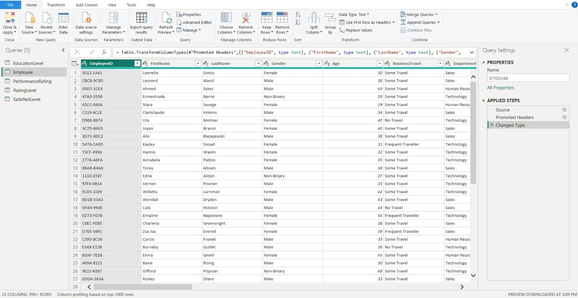
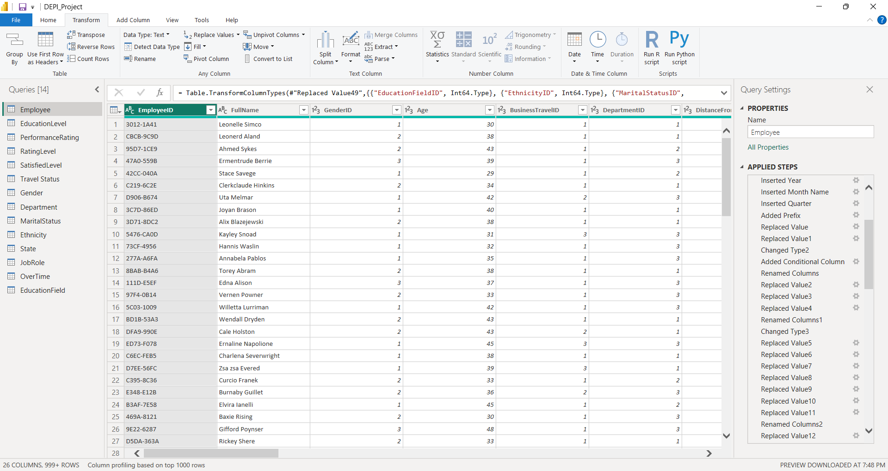
Data Cleaning
01

Slide 8
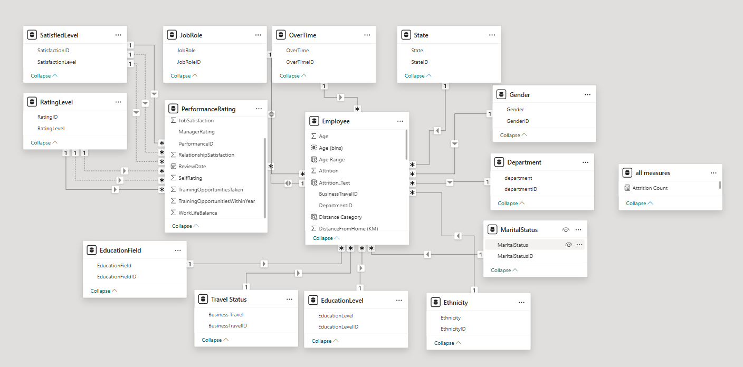
Data Modelling
02
.

Slide 9
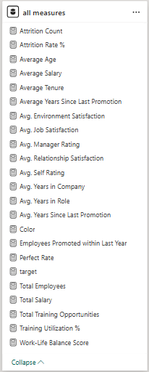
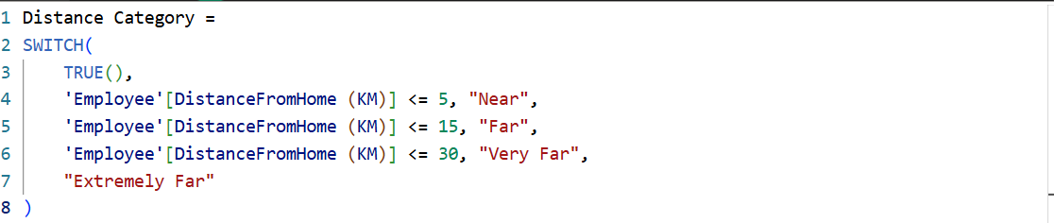
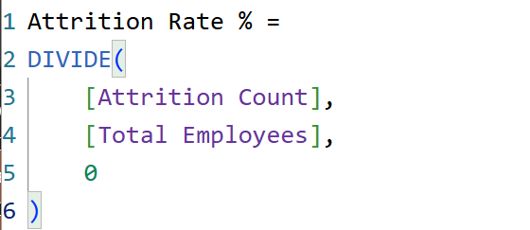
Dax
03
.

Slide 10
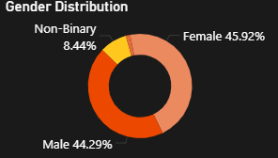
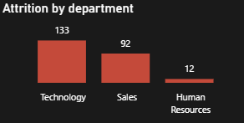
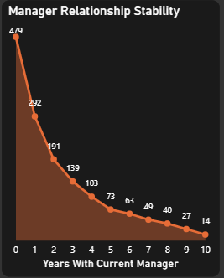
Visual Sample
04
Pie Charts
Used to show the percentage of each part of the total data quickly and easily.
Column Chart
Used to compare different values and quantities
clearly and easily.
Area Graph
Used to show data trends over time while highlighting the total volume of the area.

Slide 11
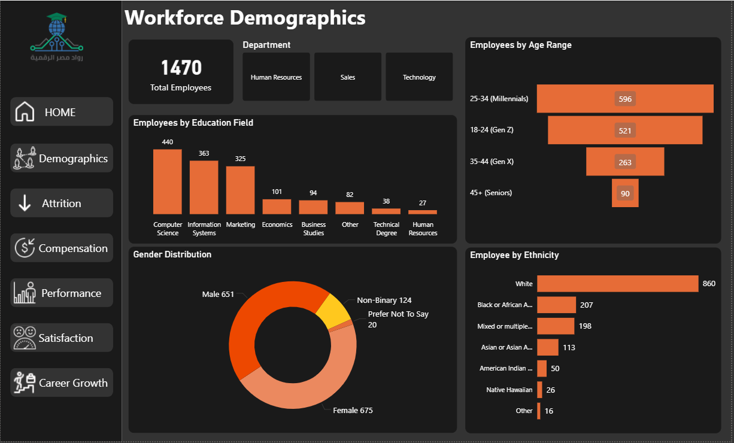
Reports
05

Slide 12
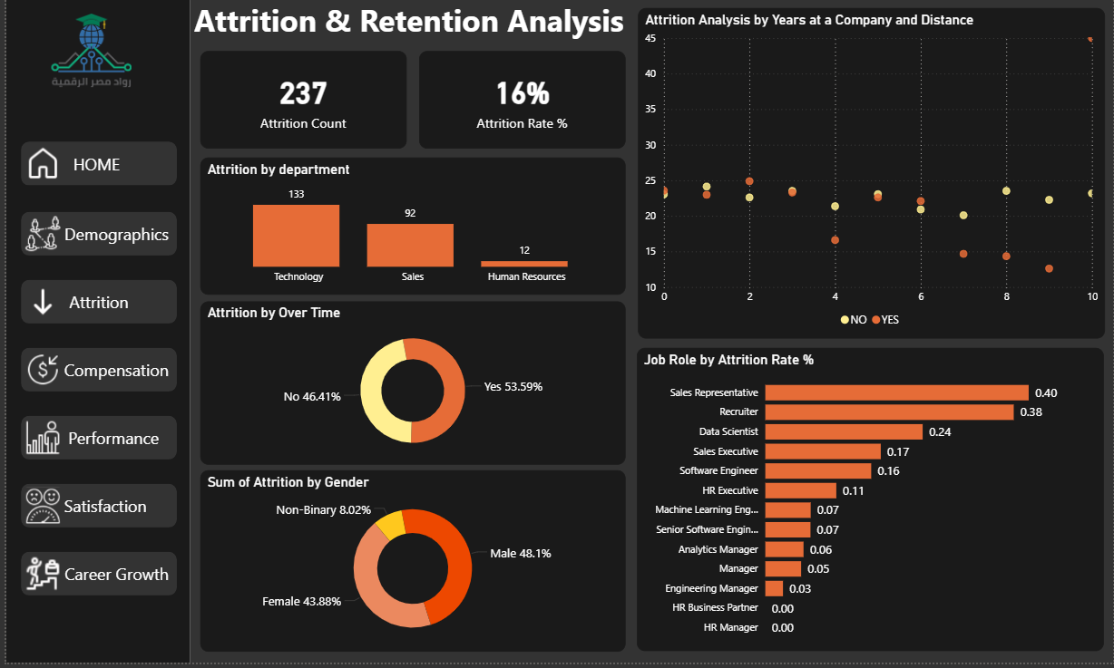
Reports
05

Slide 13
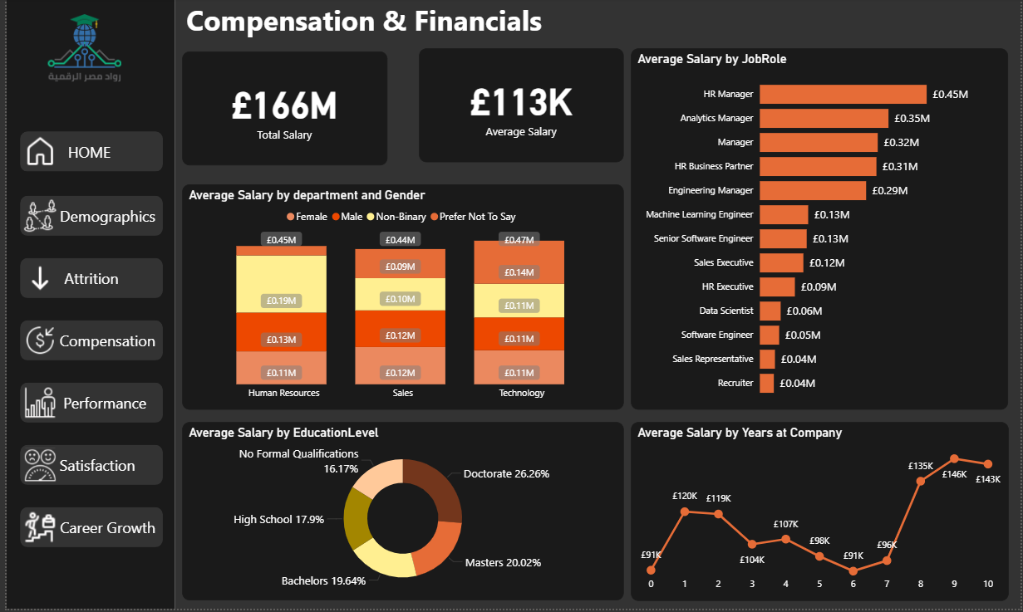
Reports
05

Slide 14
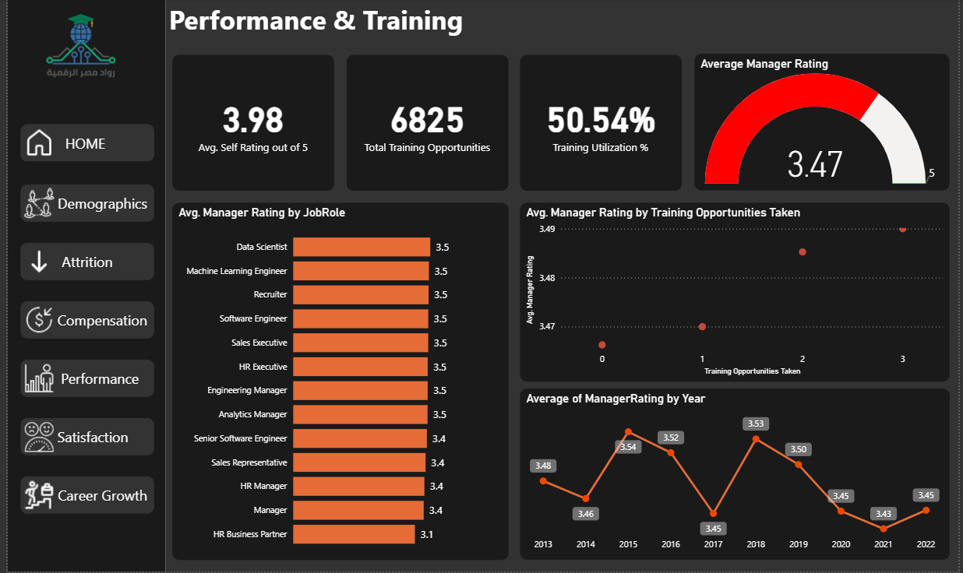
Reports
05

Slide 15
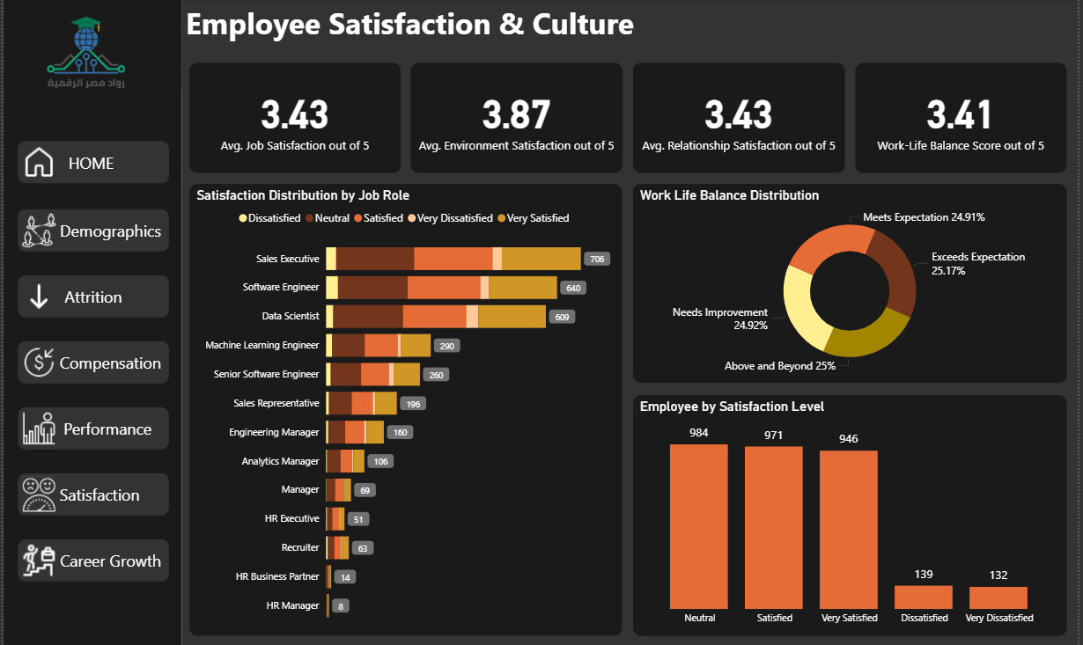
Reports
05

Slide 16
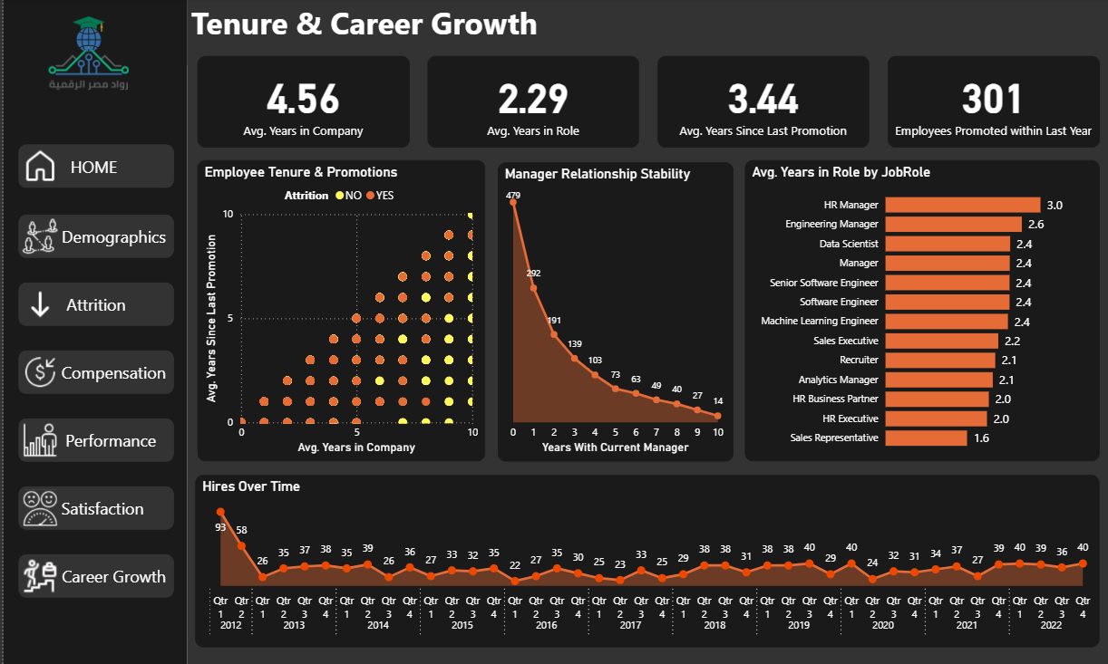
Reports
05

Slide 17
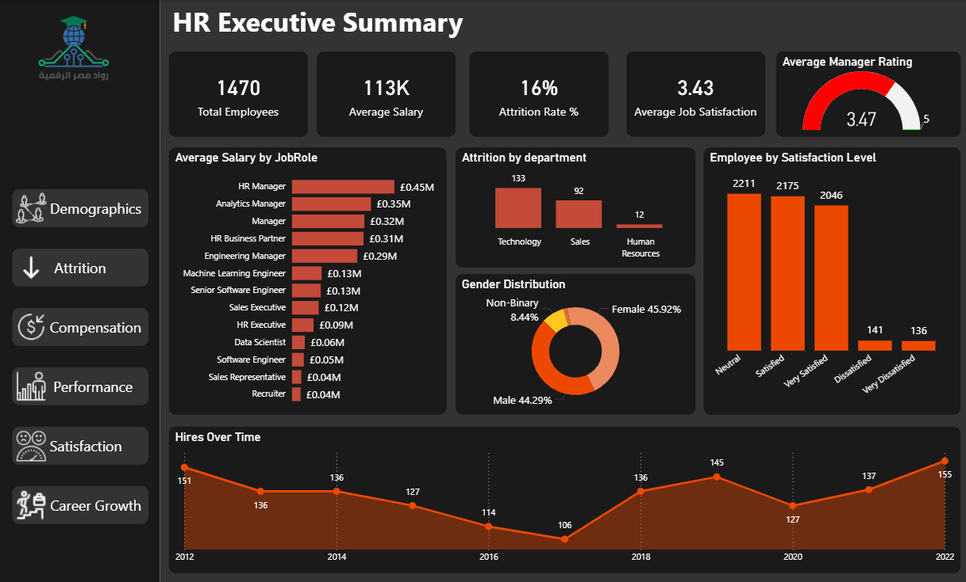
HR Executive Summary Dashboard
06

Slide 18
Insights
07
Insight Area | Key Finding | Business Impact / Recommendation
Employee Satisfaction | Most employees fall within the High and Very High satisfaction categories, indicating a generally engaged workforce. | Maintain current engagement initiatives while focusing on roles or departments with lower satisfaction levels.
Work-Life Balance | Poor work-life balance is strongly associated with higher attrition, particularly among employees working overtime. | Introduce workload balancing, flexible work arrangements, and overtime management policies.
Training Effectiveness | Employees who participate in more training opportunities tend to receive higher manager ratings. | Continue investing in learning and development programs to improve performance and employee growth.
Career Growth | Employees with longer periods in the same role or extended time since their last promotion show increased disengagement and turnover risk. | Review promotion pathways and create clearer career advancement opportunities.
Manager Effectiveness | Lower manager ratings often coincide with lower relationship satisfaction and higher employee turnover. | Prioritize leadership development, coaching, and manager effectiveness programs.
Compensation Progression | Salary growth tends to slow after several years of tenure, potentially creating a "loyalty penalty" for long-serving employees. | Conduct periodic salary reviews to ensure experienced employees remain competitively compensated.
Pay Equity | Salary differences between genders within the same department may indicate potential pay equity concerns. | Perform regular pay equity audits to ensure fair and equitable compensation practices.

Slide 19

Thank You
GitHub

